Slide 1
Weather Means
Business™
Michelle Boockoff-Bajdek
Vice President, Global Marketing
Notes:
Title Slide
Objective: Introduce yourself; set the stage for the video

Slide 2


Slide 3


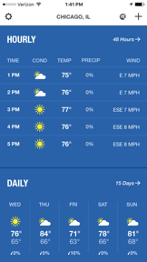
Weather is a daily habit for
CONSUMERS
Notes:
Objective: Communicate ubiquity of weather and The Weather Company
Notes:
Weather is a daily habit. 90% of all US adults consume weather information on a weekly basis. Weather touches every life, every day.
The Weather Company, an IBM Business, is the world's largest private weather enterprise, helping consumers make informed decisions – and take action – in the face of weather. We offer the most precise, personalized and actionable weather data and insights to the millions of consumers who rely on us every single day.
Our portfolio includes the fourth most downloaded app, the world largest network of personal weather stations, the seventh most data-rich website, one of the world’s largest IoT data platforms and a host of industry solutions.
In addition to our own properties, but we also power the weather for Apple, FB, Google, Microsoft, Twitter, Yahoo and more.
.

Slide 4

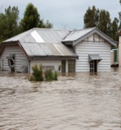


Weather Impacts Every Business
Aviation
Retail
Media &
Entertainment
Insurance

Slide 5




Weather Impacts Every Business
Utilities
Oil & Gas
Ground
Transportation
Financial
Services
Agriculture
Notes:
Upstream, Oil companies need to optimize their rigs for storm readiness, particularly during massive storms and to anticipate and avoid costly equipment failures. Downstream: they need to use weather data and analytics to support supply chain, distribution and franchise management support.
Utility companies that need to understand how much power will be consumed on any given day.
Farmer has to decide whether to plant.... if there is a 24% probability in the forecast that it's 32 degrees on day 6 they may hold off

Slide 6
Globally, we have more than
We Are
The Weather Company
200,000+ personal weather stations
200 million mobile app downloads
750+ TV stations globally
180 million consumers
5,000+ businesses
140 airlines served
Notes:
Objective: Communicate the value of our assets and our client portfolio
The Weather Company offers data-driven products and services to more than 5,000 clients in a number of industry sectors around the globe as is considered one of the largest providers globally of atmospheric and weather data
We run one of the world’s most used cloud data platforms, with thousands of partners requesting weather data through hundreds of billions of daily transactions.
We update our forecasts every 15 minutes for up to 2.2 billion locations around the world, generating approx. 20 billion forecasts per day on average
Our personal weather station network has grown to more than 200,000 reporting stations globally
We gather weather data from more than 150 different sources – data like pollen, turbulence, radar, satellite imagery, traffic, personal weather stations, smartphone pressure sensors and more.
We have more than 140 meteorologists at The Weather Company in a variety of roles. Many are dedicated to analyzing and forecasting the weather; some use that expertise in other roles, such as software engineering or sales.
But what makes us truly unique is that we are a company that serves both consumers and businesses, which allows us to leverage our presence in both markets to create the richest, most precise data sets; translate that data into valuable insights; and deliver decision platforms and services that prompt action.

Slide 7
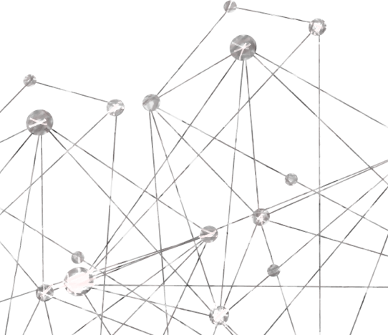
Our Story is About Data at Scale
Internet of Things
Notes:
What makes our weather story so good is the value of the data. When we talk about it, we focus on SCALE, PRECISION and ACCURACY
Objective of slides 7-10: Tell the story of SCALE
I’m sure this comes as no surprise to any of you, but these devices we all have, changed our lives and that’s not hyperbole.. It caused us here at The Weather Company to rethink how we handled observations. Because we want the forecast for exactly where you are, not the nearest airport. Mobile drove forecast reinvention. We recognized very quickly that we had to focus laser-like on mobile because there is this problem of scale – lots of data and the need to serve millions of people on the planet. As example, we have to serve every native IOS user around the globe for their location. Every Yahoo consumer. Every AOL consumer. Every customer coming from a Google search. The hundreds of millions coming to the Weather company proprietary platform. This is a scale problem and a global one at that.
So now, we’re pulling in data from planes, smart phones and other IoT devices. In fact, we receive:
Over 530M Personal Weather Station reports each day
Over 9M webcam uploads each day
Over 2M Crowd Reports each month
Over 50M IoT Barometric Pressure Reports each day
So, we’re talking about millions of physical devices that are collecting data about weather.

Slide 8
100x More Sensors Than Public Sources
200,000 Personal Weather Stations
Legend:
Airport sensors Personal weather sensors
Notes:
Our personal weather station network is the backbone of our IoT strategy. With more than 200,000 Personal Weather Stations across 195 Countries, this network enables The Weather Company to provide hyper local forecasts to millions around the world with unprecedented accuracy. . You can see here the red dots indicate government reporting stations while the blue dots represent personal weather stations. We deliver 100x more coverage than publically available sources anywhere on the globe.
Each station is equipped with multiple sensors for detecting barometric pressure, humidity, temperature, wind speed and direction, and other factors. Greater personal weather station data leads to more precise and enhanced forecasts, which can help businesses, governments and communities better anticipate and act on weather conditions.

Slide 9



Collecting Data From
50,000
Flights
Commercial Aviation
Every Single Day
Notes:
We’re currently collecting data from more than 50k commercial flights per day. And thanks to a partnership with Gogo, we’ll now leverage their expanded fleet of aircraft to both gather and transmit data, like turbulence reports.

Slide 10

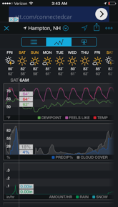
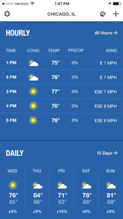
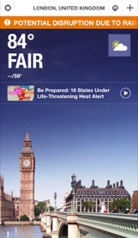
15 MILLION DEVICES
Contributing Pressure and Location Data
Notes:
As a result of the data, technology and human expertise, we’ve able to map the atmosphere. And that’s enabled us to develop one of the richest location data sets in the world. More than 80% of our users opt-in to share their location with us. And, if you consider the fact that we have 20 million daily users who check in 2-5 times per day…we are mapping 1 billion location pings per week. This means we possesses one of the world’s largest continuous sets of first-party location data. There are very few companies with location data as accurate and as precise as ours.

Slide 11
The Data Story is Also About Precision
Currents on Demand for
2.2 Billion Points On Earth
Notes:
Objective: Tell the story of PRECISION
Because weather is hyper-local and can differ on a neighborhood by neighborhood basis. Here you can see the temperature differential within just a few kilometers. If you live within 2km of a weather reporting station, your forecast is 15% more accurate.

Slide 12

And Accuracy
162 Forecast Models
A Single Forecast Model Doesn’t Produce The Best Results; A Combination of 162 Models Does
Notes:
Objective of slides 12-14: Tell the story of ACCURACY
The best forecast model in the world doesn’t produce the best forecast. A combination of 162 models does.

Slide 13












Forecasts On-Demand
2015 US 1-3 Day Temperature Forecast RMS Errors
Various government forecast models
Notes:
For our Forecasts on Demand solution, we bring in 162 different sources and models –Japanese, Canadians, brits, US, EURO, our own models. All of these different inputs. Now, there are times when a single model will produce a better forecast. But our approach ON AVERAGE produces a better forecast day 1, day 5, day 10 - Tokyo, Bangkok, Rio, Austin. And, we intelligently weight every forecast input to come ups with a better forecast. And we are really smart about the weighting. Which will differ by location, type of weather, time of year. So many different variables.

Slide 14
Probability Forecasts
Decisions made without probability-based analytics will always result insuboptimal economic outcomes
86.4% probability of snowfall
0 inches – 1st most probable outcome
10 inches – 2nd most probable outcome
4.8 in.– least error forecast (FOD today)
Percent
4.5 in.– 50% probability forecast
31.1% probability of 10 inches or more
Snowfall (inches)
Notes:
Objective: Tell the story of Probabilistic Forecasting and why it’s the future.
We’re showing you a probabilistic forecast for a storm earlier this year. On the day of the storm on the consumer app, the forecast for this particular location was for 4.8 inches of snow. When give a single answer, we’re providing the one that minimizes error of forecast. Our goal is to be as close to right as possible.
But there is a LOT of data in this forecast that is not captured by 4.8 inches. For example, in this particular case, the most probable outcome - from 0-16 inches - is 0 inches while the second most probable outcome is 10 inches. And the least error forecast is 5. All three of those numbers are reasonable to focus on. But when you understand the probability or likelihood of 10+ inches, which in this case is greater than 30%, you will make different decisions that you would if the probability were only 5%.
So, a probabilistic forecast system that provides a broad view of probabilities will lead to better, more informed decisions that result in better outcomes.
$1M a mile to evacuate people. You want to know the probability.

Slide 15
The Weather Company Data Packages
WHEN
Historical
Ex. “What was the weather
X days ago?”
Current
Ex. “What is the weather
right NOW?”
Immediate Future
Ex. “What will the weather be on X date?”
Beyond
Ex. “What will the weather be
like in the next few months?”
INFORMATION TYPES
Site Based Weather Observations
Weather Forecasts
Seasonal Forecast
Severe Weather Reports
Weather Imagery
Weather Alerts
Probabilistic Data Packages available in 2017
Road Conditions
Tropical Storms
*Note – data availability can differ by geography and region
Notes:
Objective: Underscore value of weather data in decision making; highlight that probabilistic will be available next year.
And probabilistic forecast data will be available in key weather data packages from The Weather Company early next year. At present, we offer a number of options – historical, current and forecast data that can be used to analyze, predict and make decisions.
Site Based Weather Observations
Weather observations from stations and crowd-sourced sensors including temperature, wind, humidity, pressure, dew point, visibility, and UV Index
Severe Weather Reports
Hail (US only), tornado, wind, hurricane, snow, rain, ice, and lightning reports in real-time and historical observations
Weather Imagery
Radar, doppler, and satellite imagery updated 5-60 minutes.
Road Conditions
Accumulations and intensity of rain, snow, and ice
Weather Alerts
Severe weather, wildfire, and earthquake alerts in real-time
Tropical Storms
Probabilistic hurricane forecasts up to 15 days; water levels, surges, and wave height levels up to 48 hours
Weather Forecasts
Hyper-local weather forecasts, including 1-hour windows up to 24 hours and 6-hour windows 1-15 days in the future. Includes severe weather and storm path predictions
Seasonal Forecast
Comprehensive long-range forecast beyond traditional 15-day forecast. Temperature and precipitation anomaly predictions extend 4 months into the future.

Slide 16
Cognitive Driven Decisions
Weather
+
Insights
+
Cognition
BETTER
OUTCOMES
Notes:
Objective of slides 17-21: Introduce and tell the story of COGNITIVE
So why do we do all of this? Because at the end of the day, the most precise and accurate data…at scale yields insights that drive better decisions...sooner.
Today, however, 88% of all data is dark. Sources like dark data - - data that is invisible to computers - - like data found in unstructured information – books, emails, tweets, journals, blogs, images, sound and videos.
The challenge here is that this pool of dark matter is only going to get bigger. Therefore businesses need a fundamentally different approach to the infrastructure they have today.
This is why the combination of MAN & MACHINE is so important – because together, they have the ability to illuminate that dark data as well as other types of data like atmospheric data, weather, sentiment, etc. Let’s be clear: the physical world is becoming instrumented and there is a risk for disruption for companies that don’t participate. That is the significance of cognitive computing and Watson

Slide 17
Most Analytics Are Based On Observations
Most historic weather data is based on airport observations
Notes:
At The Weather Company, we are on the path to cognitive.
As a starting point on our journey, we start with predictive analytics. So, a question for you: Why aren’t businesses doing something about weather? Let’s take a deeper dive. Most analytics are based on airport observations. Traditional weather analytics efforts fail because businesses are looking at the weather for an airport for a day. They are getting simply a daily output for the nearest government reporting station. So just imagine a large quick service restaurant chain in the San Francisco area with 30+ locations. They’re using data from the airport location that, in this case, just happens to be right outside of San Francisco. So why is that a bad thing?

Slide 18
Precise Data Brings Analytics to Life
Hyper Local
Notes:
Because as we discussed before, weather is hyper-local and precision is paramount. This is the San Francisco Bay area. Remember, we said that If you live within 2km of a weather reporting station you will receive a forecast that is 15% more accurate. And in analytics 15% makes an incredible amount of difference. Imagine if there were severe weather over just a small portion of this? Consumer behavior changes in the places where it’s pouring. So, you’ll reach a completely different conclusion about store traffic and staffing for a retail outlet or quick service restaurant (QSR) at an area where it is raining heavily.

Slide 19
PASSENGERS & CREW
Detect & mitigate turbulence risks to prevent injury & unplanned maintenance
Cognitive Is Transforming
Aviation
Protect ground crew & comply with safety policies by providing vital alerts about imminent severe weather
WORKER SAFETY
Avoid bottlenecks on the ground with surface movement monitoring
OPERATIONS
Determine the proper amount of fuel contingency required, reducing unnecessary costs
OVERALL AIRLINE
Notes:
In Aviation, we see cognitive as a co-pilot, helping to detect and mitigate turbulence; optimize flight routing; determine fuel contingency needs; and monitoring aircraft both on the ground and in the air.

Slide 20

Cognitive Is Transforming
Energy
ENERGY
TRADING
Use probabilistic forecasts to improve trading decisions
Predict outages to prevent damage and recover assets in wake of extreme weather
UTILITIES
Improve renewable energy generation predictability
RENEWABLES
Safeguard critical infrastructure and protect field workers
OIL & GAS
Notes:
In the Energy sector, we can:
Improve trading decisions, thereby increasing trader profitability
Improve grid resiliency by helping utility operators prevent, recover and survive in the wake of extreme weather
Support investment in renewables through improvements in generation predictability
Safeguard critical infrastructure and protect field workers against extreme weather events - both on and off shore

Slide 21
24+
ingested per day in production
The SUN Platform
Terabyte
compressed
A cloud-based data platform that ingests large volumes & types of data
Delivers insights from precise weather data combined with location and other data sets
Enables companies to embed weather insights into decision support platforms to take take action
100s
Petabytes
analyzed and stored
in data lakes
15 Billion
handled per day
API requests
>100
supported today
data types
Notes:
Objective of slides 22-24: Introduce the SUN Platform
The work we do, however, is only as good as the foundation supporting it. The SUN platform is our cloud-based data platform that ingests more than 24 terabytes of data a day. More than 100 different types of data. The platform supports not only the ingestion of data, but the transformation so that it can be used for analytic purposes.

Slide 22



Applying Analytics to Weather
IoT / Data
Smart phones
Homes
Planes
Sensors
Cars
Hyper-Local Weather Data
Analytics
Consumers
receive alerts on mobile devices
Businesses
can offer savings, engage customers, intro new features
alert
SUN PLATFORM
Notes:
As an example, various forms of data come into the platform – both IoT sensor based data, but also our hyper-local weather data. It is then made available to analytics applications where that data can be used to provide consumers with the information they need to plan their days, plan for and act in the face of severe weather, or receive ads that are both personalized and relevant to them in the moment.
Businesses can personalize offers to consumers, engaging them in ways never seen before (Watson ads). They can also improve business performance by making smarter decisions about everything from staffing to asset maintenance; from optimal transportation routes to claim mitigation.

Slide 23
Using Analytics to Engage Customers
Home IoT Sensors
H20 meter
A/C
Electrical panel
Sewer System
Hyper-Local Weather Data
Analytics
40,000 smart home sensors
10,000 home owners with mobile or website warnings
300 Insurance workers who want to study their clients water usage & warnings
Home owner alerted on mobile device
Insurance provider
can offer savings, alerts, new features
alert
SUN PLATFORM
Notes:
Here is an example of how SUN could work in insurance. In this case, insurance companies want to know who might be at risk for a claim or who might be a good upsell / cross sell target. By understanding consumer behavior in the home AND marrying that with weather data, insurers have a much better picture of who to target and when.

Slide 24




Media & Entertainment
Travel & Transportation
Energy & Utilities Oil & Gas
Agriculture
Insurance & Financial Services
Retail
Delivering Better Business Outcomes
DECISIONS
Weather Solutions & Use Cases
Notes:
Objective of slides 25 – 31 – Tell the story through USE CASES.
At the end of the day, the most precise, accurate data…at scale yields insights that drive better decisions...sooner, which lead to more favorable outcomes. Let’s take a look at some of the solutions The Weather Company offers and the use cases that show them in action.

Slide 25

The Weather Company Alerts
Hyper-local, personalized, actionable weather alerts that are quick and easy to configure
Engagement
Build customer loyalty & retention with more touchpoint opportunities
Worker Safety
Standardized, consistent & automated alerts to prevent injury
Demand Shift
More informed operations, staffing, stocking & placement decisions
2cm hailstones will arrive in about 30 minutes. Consider protecting your vehicle and property.
Lightning 2.1 mi. from you. Take cover immediately.
Mid-afternoon showers will drive demand for rain gear. Plan staffing and placement.
Notes:
Alerts is a solution designed to help companies in all sectors strengthen customer relationships through more personalized touchpoints; for those with field workers, like utilities and telecommunications companies – keep them safe from the perils of hazardous weather and for retailers, make more informed decisions about staffing, store stocking and product placement. Powered by The Weather Company data, Alerts is a SaaS based offering that delivers localized, timely and pre-built notifications to deliver important – and potentially life-saving – information to the platform of choice.

Slide 26
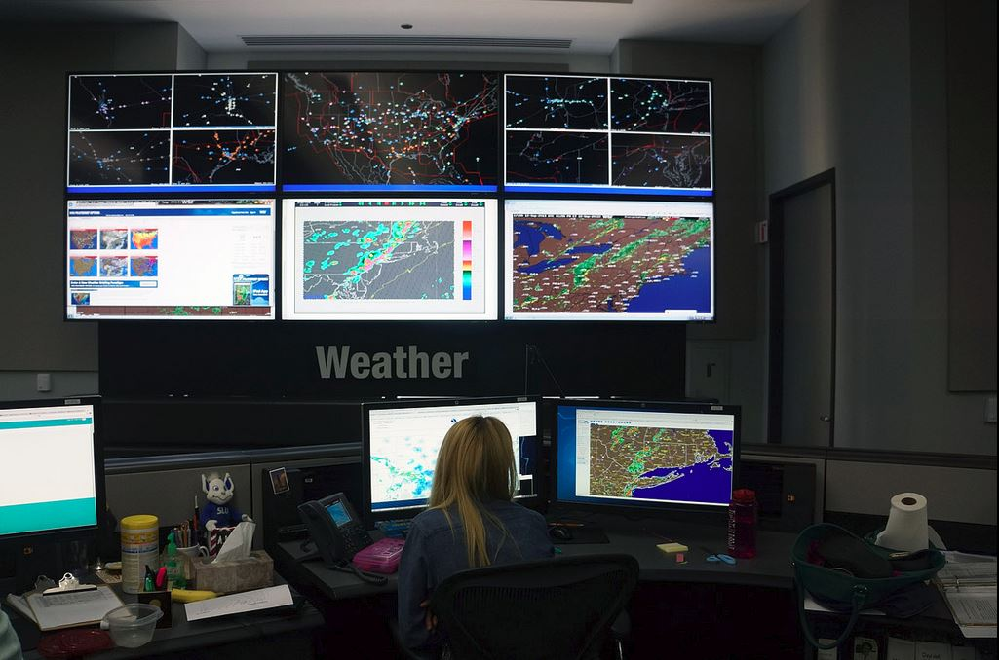
Aviation
Weather Solutions
50%
REDUCTION
Turbulence Avoidance
Predictive Analytics
Forecast Services
Enroute Hazards
of crew injuries &
maintenance inspections
11% decline
of airline cancellations
Notes:
The Weather Company provides mission critical applications to the aviation industry and most notably commercial aviation. At present, we serve 45 of the Top 100 global airlines and 13 of the top 20. We work with more than 140 airlines around the world to ensure safe, efficient and on-time operations through a platform of services. Our approach has been to deliver the most precise, actionable weather, transform that data into insights that improve safety and the bottom line while optimizing business performance.
Use Cases:
Turbulence. Turbulence costs a typical large airline $3M annually in crew injury and maintenance costs. To help airlines mitigate the risks, we collect real-time turbulence observations from aircraft equipped with sensors and then send real-time alerts to dispatchers and crew of imminent hazards. Finally, we provide solutions that enable dispatchers and pilots to use those insights to alter routes to either avoid turbulence or encourage crew and passengers to buckle up. As a result, we’ve been able to help individual airlines save 50% in injuries related to turbulence and unplanned maintenance inspections.
Ramp Safety. The timing and duration of ramp closures due to severe weather threats cause flight delays and propagates downstream. By delivering early insights into severe weather threats, including the exact timing of impact, The Weather Company allows airlines to more precisely plan ramp closures and shortens the time to full recovery, significantly reducing impact on operations and saving costs. The value? A major airline saves $1.7M annually by reducing delays by 10 minutes during peak time at O’Hare Airport, Chicago, IL.

Slide 27
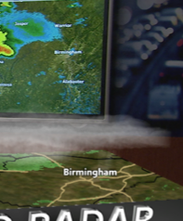
Media
Weather Solutions
5%
LIFT
Broadcast
Digital & Mobile
Audience Alerts
in morning ratings
2x mobile page views
from customized push alerts
Notes:
Every market has its own kind of disruptive weather. And every television station must forecast, detect and visualize that weather for their audience in their own way, reflecting their own news brand. The Weather Company’s suite of Television, Mobile and Online products allow weather stations and broadcasters to choose from among the most advanced sets of weather data, broadcast production tools and visualization features for all platforms.
Today, we serve more than 700 stations globally, helping them remain essential to the lives of their audiences.
Use Cases:
Mobile Engagement – By 2018, 51% of Americans will view video on a mobile device and video ad revenue will double to $5B. Local television needs to leverage mobile video to monetize their audience. The Weather Company helps these stations by giving them the tools to drive automated, push notifications that deliver hyper-local, contextually relevant stories made for video to garner more eyeballs and higher CPM rates.
A Daily Habit – Overall, local TV news viewership has declined, while morning viewership has grown and is a primary source of revenue for stations and station groups. Stations must differentiate in the mornings to gain younger audiences that are more attractive to advertisers. With The Weather Company, stations can deliver hyper-local real-time traffic and weather information, particularly during morning commute times. They can publish content, including up-to-the-minute reports across digital platforms that audiences come back to throughout the day.

Slide 28
Energy
Weather Solutions
Savings of
$9 Million
generated from integrated load forecasting approach
Trading
Load Forecasting
Can generate
$800,000
more per year on a average-sized trade floor
Notes:
The Weather Company’s suite of products for Energy & Utilities delivers accurate weather forecasting that improve energy trading decisions, long range planning, outage prediction and predictive asset maintenance. The industry’s most reliable, easy-to-use web-based forecasts, long-range outlooks and historical data allow our clients to better predict load and natural gas demand.
Use Cases:
1. Load Forecasting – Energy traders and utility companies need the most skillful weather forecasts to better predict energy demand and the associated price of electricity. At The Weather Company, we translate skillfull short and medium range forecasts by location into energy demand forecasts to help improve energy demand planning and price predictions.

Slide 29
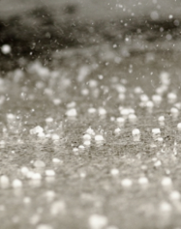
Insurance
Weather Solutions
52%
AVOIDANCE
Customer Engagement
Claims Management
Risk Avoidance
of potential claims costs
Notes:
Real-time weather forecasting is essential for truly differentiated response to extreme weather events, like flooding and tropical storms. The Weather Company helps insurers bring together insights from real-time weather data feeds to improve operational performance and decision-making around weather risk assessment, severe weather event preparation, loss prevention, forensic meteorology, and disaster response and recovery.
Use Cases:
Proactive Alerts - For insurance companies, the least costly event is the one that never occurs. Insurers also need to create better customer experiences by helping policyholders protect life and property in the face of significant weather events. Weather data can provide insight into significant and hazardous weather events. Proactive alerts to customers in the path of potential damage from an impending storms can provide significant savings for both customers and insurance carriers. In fact, we’ve seen that when you alert people to imminent hail, encouraging them to take action to protect both life and property, 52% of the people will take action.

Slide 30

Retail
Weather Solutions
24%
INCREASE
Demand Insight Staffing
Advertising Solutions
in sales year-over-year
Notes:
What are your customers looking to buy and when? Retailers need to know what’s coming their way — especially when it comes to weather. With a best-in-class suite of custom weather solutions for retail, our customers can better understand how weather affects store traffic patterns and consumer buying habits. So, they can better manage inventory allocation, refine staffing and operations, and generate geo-targeted weather triggered ads that drive sales — and increase brand loyalty. Use Cases:
Weather-Triggered Ads – Retail and CPG companies need to better leverage historic, current and forecasted weather conditions to guide their marketing campaigns and improve effectiveness. The Weather Company delivers precise hour-by-hour weather and location data to help retailers understand the impact of weather on retail sales by both location and season. With that insight, marketers can run geo-located, weather triggered ads at scale that are contextually relevant to audiences and influence buying behaviors.

Slide 31





3
KEY
TAKEAWAYS
Collecting more data
to achieve higher level of precision and accuracy
Embedding analytics
into all solutions
Driving to decisions
helping to deliver better outcomes
Notes:
Summary slide

Slide 32

Thank
You
Michelle Boockoff-Bajdek
Vice President, Global Marketing

